Slide 1
Statistical concepts and methods

Slide 2

Statistics: a branch of mathematics dealing with the collection, analysis, interpretation, and presentation of numerical data.
Descriptive Statistics: describes, presents, summarises and organises data via numerical calculations or graphs or tables.
Inferential Statistics: draws conclusions about all possible data on a subject (population) using only some of the data (sample).
Probability: studies and analyses random phenomena (chance events).
Statistics and its branches

Slide 3
Main statistical concepts:
Precision and bias
Data richness
Population and sample
Robustness
Statistical concepts

Slide 4
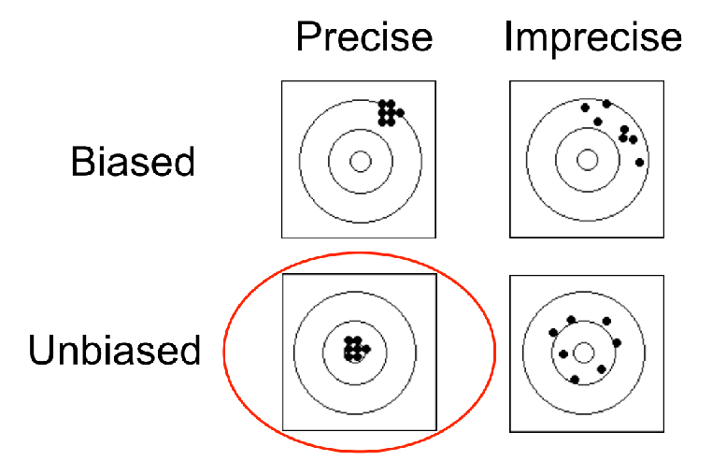
Precision and bias are components of accuracy.
Bias is a measure of how far the expected value of the estimate is from the true value of the parameter.
Precision is a measure of how similar the multiple estimates are to each other (not how close they are to the true value - bias).
Source: https://www.statstutor.ac.uk/resources/uploaded/1introduction3.pdf
Precision and bias
Notes:
Bias and Variance help us in parameter tuning and deciding better-fitted models among several built.
Bias is one type of error that occurs due to wrong assumptions about data such as assuming data is linear when in reality, data follows a complex function. On the other hand, variance gets introduced with high sensitivity to variations in training data. This also is one type of error since we want to make our model robust against noise. There are two types of error in machine learning. Reducible error and Irreducible error. Bias and Variance come under reducible error.
What is Bias?
Bias is simply defined as the inability of the model because of that there is some difference or error occurring between the model’s predicted value and the actual value. These differences between actual or expected values and the predicted values are known as error or bias error or error due to bias. Bias is a systematic error that occurs due to wrong assumptions in the machine learning process.
Let be the true value of a parameter, and let be an estimator of based on a sample of data. Then, the bias of the estimator is given by:
where is the expected value of the estimator . It is the measurement of the model that how well it fits the data.
Precision refers to how consistently a tool or process can produce similar results under the same conditions. It is about repeatability and reliability, not necessarily how close these results are to the true or intended value.
If we weigh something five times and each time the scale reads exactly 4.6 kg, our measurements are precise. They consistently show the same result.
Precision can be further broken down into two aspects:
Repeatability
Reproducibility
Repeatability
Repeatability refers to the variation in measurements taken by a single instrument or individual under unchanged conditions over a short period. For example, if we measure the length of a table several times in one sitting and get almost identical results each time, our measurements show good repeatability.
Reproducibility
Reproducibility is a measure of whether a measurement can be duplicated by different people, using different instruments, over extended periods. For example, if several different workers use different tape measures to size the same table on different days and their measurements are very close, the method is reproducible.
Precision Formula
To calculate precision, we use the formula for standard deviation, which shows how much the values in a set deviate from the average. Its formula is given by :
Standard Deviation (Precision) = √(∑(Measurement −Mean)²​​/ Number of measurements)

Slide 5
POPULATION AND SAMPLE
Population
All members of a group – which may be made up of people or things. The size of the group can be large or small, depending on what you’re interested in.
Sample
A subset of the population you’re interested in. Statistical studies typically involve working with samples as collecting data on the whole population is often time consuming, expensive or impossible to do. The sample strategy you use needs to ensure the sample chosen is representative of the population.

Slide 6
Sampling methods and bias
Population
Sample
Random sampling
Not random sampling
Simple random
Stratified
Clustering
Voluntary
Convenience
Response /
non-response bias
Under coverage bias
Bias
Wording bias

Slide 7
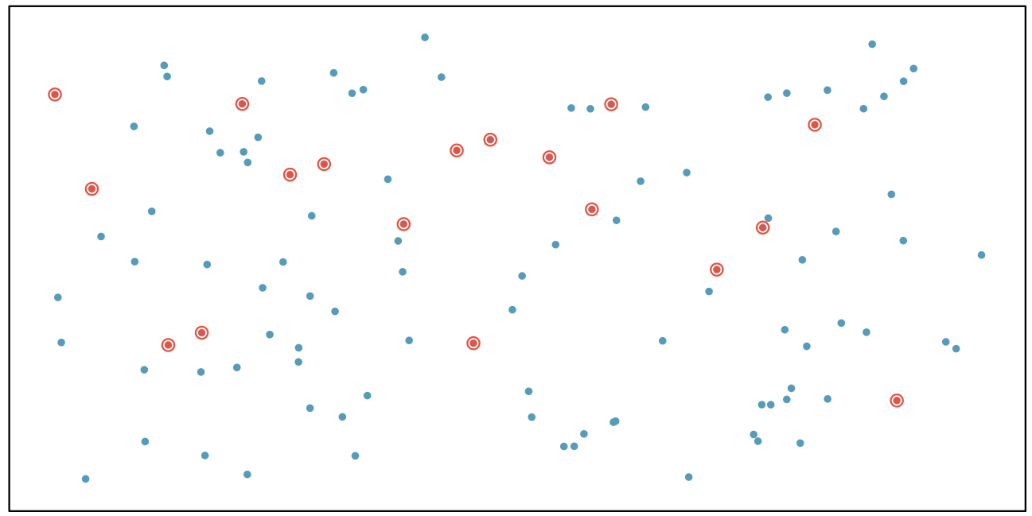
Randomly selected cases from the population, where there is no implied connection between the points that are selected.
Examples
Tossing a fair coin
Pulling names out of a hat
Random number generators
Simple random sample

Slide 8
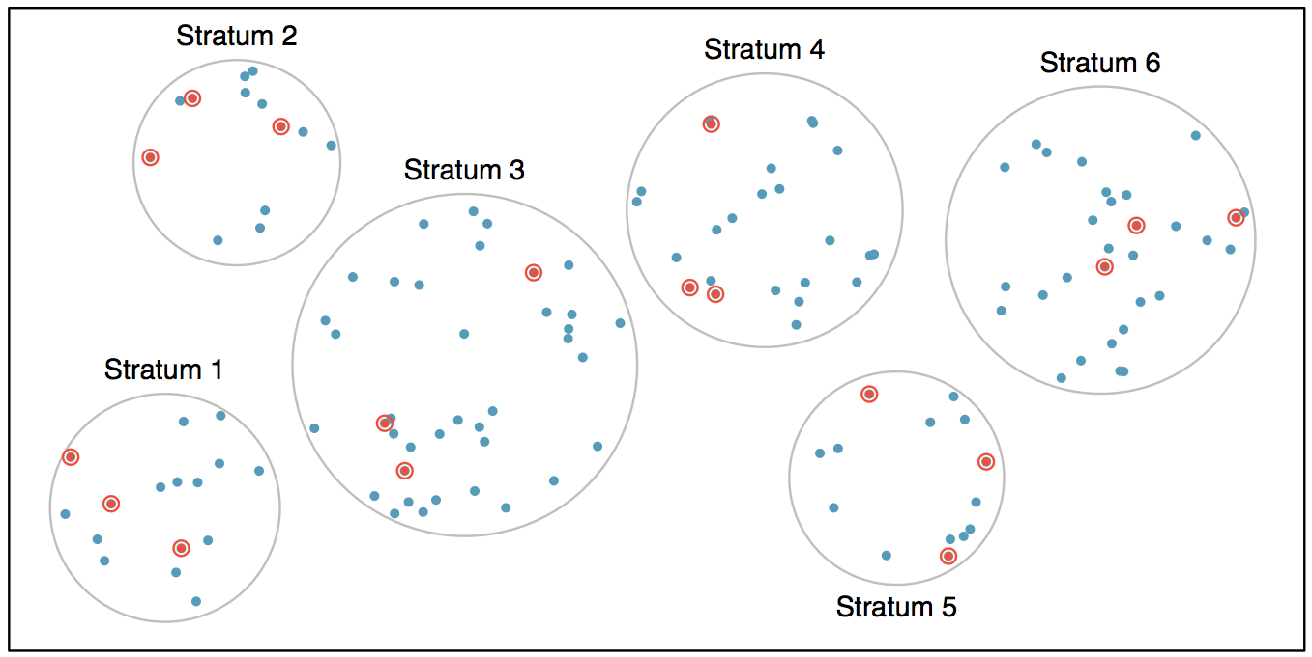
Strata are made up of similar observations. We take a simple random sample from each stratum.
Examples
Gender
Age groups
Geography
Stratified sample

Slide 9
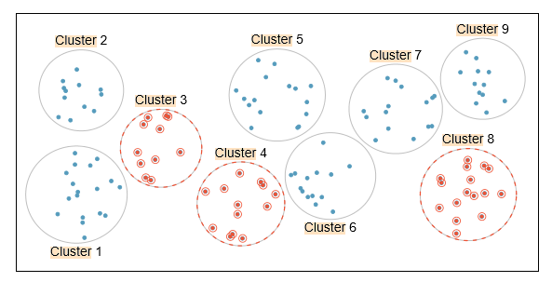
The population is first divided into groups (clusters) and then a fixed number of clusters are chosen randomly amongst all the clusters. The resulting sample will include all members from the clusters that were chosen.
Examples
Classrooms in a school
Properties within a postcode
Cluster
sample

Slide 10
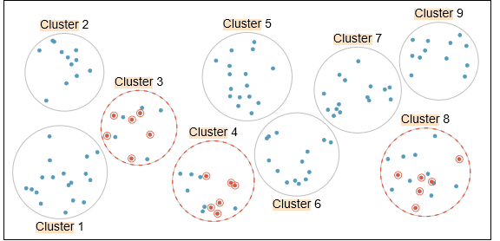
Similar to cluster sampling, except a random sample is taken from each cluster chosen, rather than all members of the cluster.
Multistage
cluster
sample

Slide 11
Statistical tests make certain assumptions. However, they often work in situations where these assumptions are violated. This is called robustness.
Example: ANOVA methods assume equal variance across the samples. However, they still work correctly when variance varies across samples (although not severely) provided that the samples are the same size.
robustness
Notes:
ANOVA tells you if the dependent variable changes according to the level of the independent variable. For example:
Your independent variable is social media use, and you assign groups to low, medium, and high levels of social media use to find out if there is a difference in hours of sleep per night.
Your independent variable is brand of soda, and you collect data on Coke, Pepsi, Sprite, and Fanta to find out if there is a difference in the price per 100ml.
You independent variable is type of fertilizer, and you treat crop fields with mixtures 1, 2 and 3 to find out if there is a difference in crop yield.
The null hypothesis (H₀) of ANOVA is that there is no difference among group means. The alternative hypothesis (H_{a}) is that at least one group differs significantly from the overall mean of the dependent variable.
If you only want to compare two groups, use a t test instead.

Slide 12
There is a large variety of statistical methods, and the choice of method depends on:
Objective of the project (study): what do we want to find out.
Relationships and their strength, so we can predict / forecast.
we would use different types of regression analysis, depending on the types of data (particularly the dependent variables).
Presence of differences
Does X cause change in Y?
Does a new blood pressure drug work (lower the blood pressure)?
Does energy use (and bills!) differ between London and Manchester?
We would use t-tests, non-parametric difference of means tests, or ANOVA.
selecting
Statistical methods

